Slide 1
Building Community Through the Indigenous Metadata Working Group
Maria Aleluia, Cataloguing Technician
Jordan Pedersen, Metadata Librarian
Oct. 4, 2022

Slide 2
Agenda
Introduction
  Background of the group
  Poll everywhere activity
  Our objectives for this session
Community building
Resources

Slide 3
introduction

Slide 4
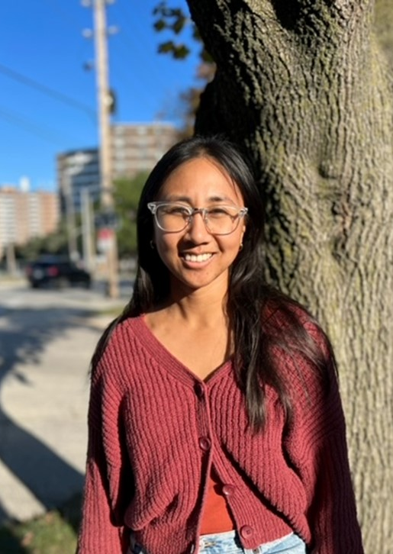
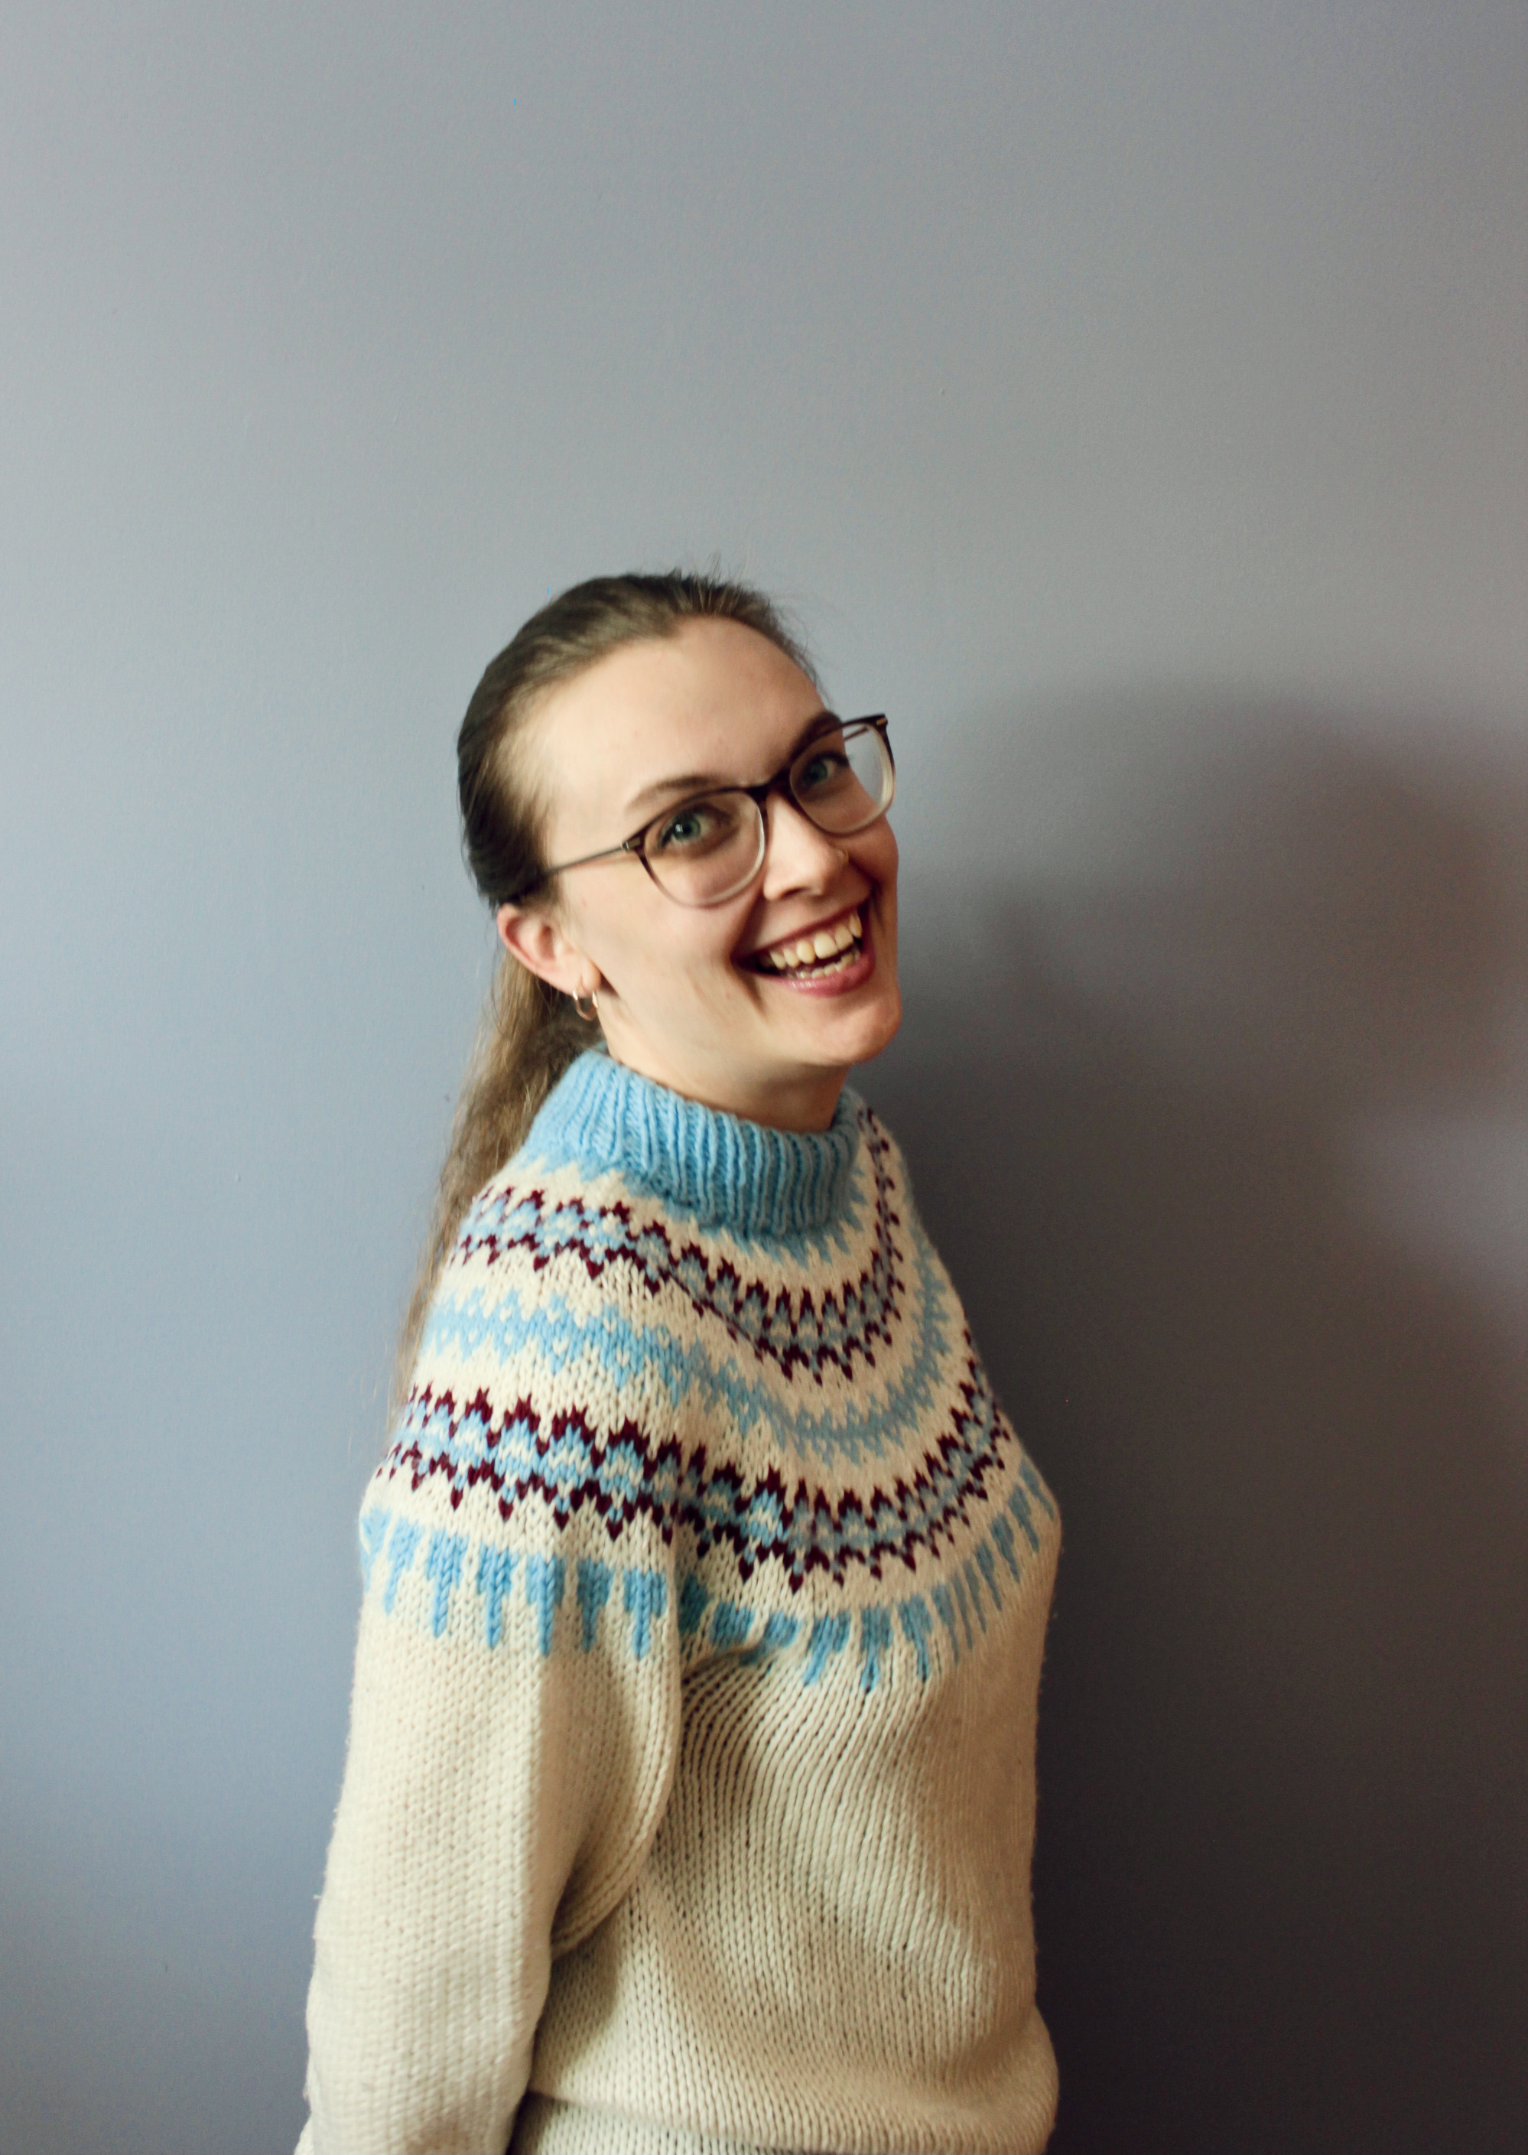
Introduction
Maria
Jordan

Slide 5
The Indigenous Metadata Working Group (IMWG)
Established February 2021
Fluctuates around 20 members with various job roles
Grew out of an Indigenous matters book club and other past initiatives

Slide 6
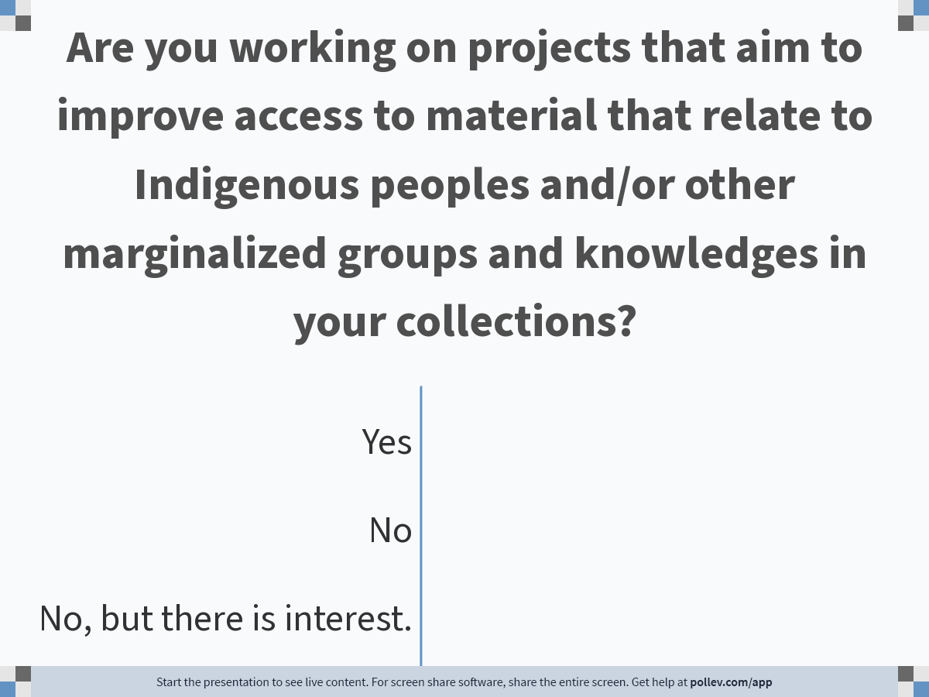
Notes:
Poll Title: Do not modify the notes in this section to avoid tampering with the Poll Everywhere activity.
More info at polleverywhere.com/support
Are you working on projects that aim to improve access to material that relate to Indigenous peoples and/or other marginalized groups and knowledges in your collections?
https://www.polleverywhere.com/multiple_choice_polls/PyzN2FueaPxA3BzzqVVo7

Slide 7
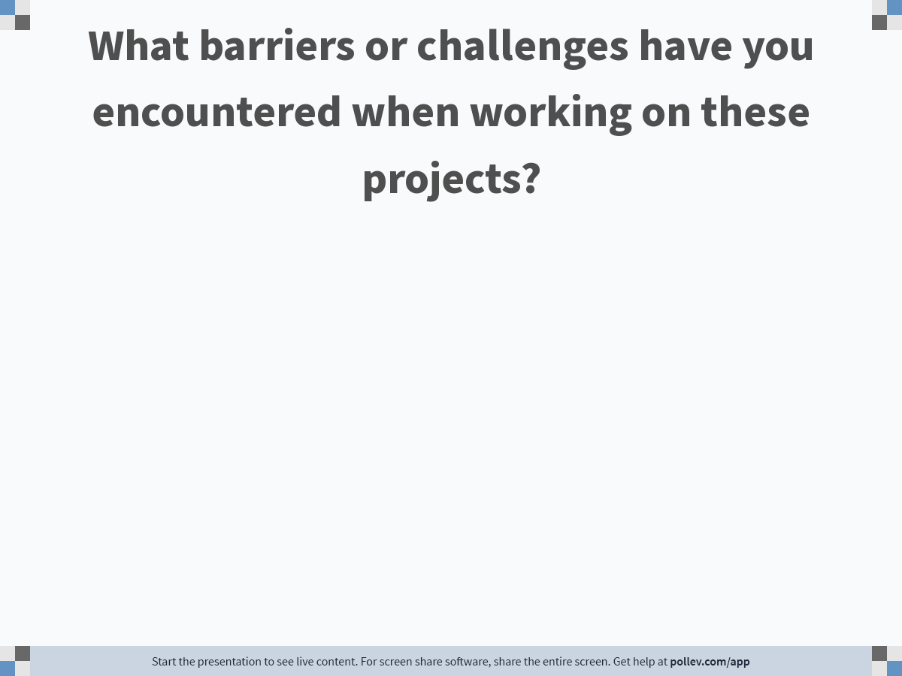
Notes:
Poll Title: Do not modify the notes in this section to avoid tampering with the Poll Everywhere activity.
More info at polleverywhere.com/support
What barriers or challenges have you encountered when working on these projects?
https://www.polleverywhere.com/free_text_polls/lYQEjhjXrudPCjddKWuxv

Slide 8
Our objectives for this session
Share reflections on the progress of our goals
  Be transparent about the discomfort that can come with participating in EDI initiatives
Connect with others who are doing similar work
Share resources that IMWG has benefitted from/used in our current projects

Slide 9
Progress of Goals
IMWG Terms of Reference and Goals
  "Use normalization rules to change the display of problematic or offensive subject headings in order to support researchers using preferred terminology in their searches."
Two projects were started to support this goal
  Subject heading masking
  Statement on harmful language

Slide 10
Steps Taken
Subject heading masking
Statement on harmful language
Survey
Sandbox Testing
Consultations
Go Live
Thematic Coding of Statements
Thematic Coding Summary
First Draft

Slide 11
Challenges
Mixed perspectives stemming from different library-related roles
  Both a challenge and a strength
Maintaining momentum
  The work is (mostly) not in people's job descriptions, so time commitments fluctuate and rely on supervisor consent
Fear of making mistakes
  Doing or saying the "wrong thing"

Slide 12
Community building

Slide 13
How did we build community?
Early initiatives to build trust and knowledge
Developing Indigenous cultural competency as a group
Incorporating member feedback into goals
Being open to flexible participation and engagement

Slide 14
Early Initiatives
Introductory meeting
Indigenous Canada MOOC

Slide 15
Developing Cultural Competency
Sharing learning opportunities (e.g., workshops) and resources (e.g., articles)
  Listserv
  Teams Channels/Chats
Learning circles

Slide 16
Learning Circles
Format
Reading choices
Feedback from the group

Slide 17
Talking Circle Slide
Name
Name
Name
Name
Name
Name
Name
Name
Name
Name
Name

Slide 18
Member Feedback
Reaching out to members and asking what they want to achieve through this group
  Using member feedback to determine the direction of future projects

Slide 19
Flexible Participation and Engagement
Being open to different ways of participation and engagement
  Encouraging use of IMWG as a resource

Slide 20
resources

Slide 21
Project
Subject Heading Masking
  Go Live documentation
    includes scripts, technical checklist, guide to searching, and limitations
Statement on Harmful Language
  Summary of Thematic Coding of Bias Statements in Library and Archives Catalogues

Slide 22
We owe a great debt to other libraries and groups who have done similar work, and we're especially grateful for the documentation shared by:
University of Manitoba - LCSH Changes in MAIN
CRKN - Interim Indigenous Subject Headings
SACO Summary of Decisions, editorial meeting number 2110 - Enslaved persons
  This change was approved and announced in March 2022 (Summary of Decisions, editorial meeting number 2203)
First Nations, Métis, and Inuit – Indigenous Ontology (FNMIIO) from NIKLA (currently in draft form)
Triangle Research Libraries Network - List of terms currently being overlaid
SUNY - List of terms and project steps
List of Statements on Bias in Library and Archives Description

Slide 23
Community Building
Indigenous Canada (MOOC)
Learning meeting format
  More information about sharing circles
Learning meeting readings

Slide 24
Thank you
Maria Aleluia, Cataloguing Technician
maria.aleluia@utoronto.ca
Jordan Pedersen, Metadata Librarian
jordan.pedersen@utoronto.ca

